Slide 1
ASP.NET 4.5 Chapter 19 Membership and Role Management
Instructor: Robert Garner

Slide 2
WHAT’S IN THIS CHAPTER?
Managing ASP.NET 4.5 authentication and authorization
Adding and managing roles
Working with ASP.NET Login server controls
Creating a customized registration process
Reviewing the Membership and Roles APIs and the controls that utilize them Integrating OAuth/OpenID authentication

Slide 3
Membership and Role Management
The authentication and authorization of users are important functions in many websites and browser— based applications.
Traditionally, when working with Microsoft’s Windows Forms applications (thick- client), you depended on Windows Integrated Authentication;
When working with browser—based applications (thin- client), you used forms authentication.
Forms authentication enabled you to take requests that were not yet authenticated and redirect them to an HTML form using HTTP client— side redirection.

Slide 4
Membership and Role Management
The user provided his login information and submitted the form.
After the application authenticated the request, the user received an HTTP cookie, which was then used on any subsequent requests.
This kind of authentication was ﬁne in many ways, but it required developers to build every element and even manage the backend mechanics of the overall system.
This task was daunting for many developers and, in most cases, it was rather time- consuming.

Slide 5
Membership and Role Management
ASP.NET 4.5 includes an authentication and authorization management service that takes care of:
Login
Authentication
Authorization
Management of users who require access to your web pages or applications
This outstanding membership and role management service is an easy-to-implement framework that works out of the box using Microsoft SQL Server as the backend data store.

Slide 6
Membership and Role Management
This framework also includes an API that allows for programmatic access to the capabilities of both the membership and role management services.
In addition, a number of membership and role management- focused server controls make it easy to create web applications that incorporate everything these services have to offer.
Before you look at the membership and role management features of ASP.NET 4.5, understanding the basic principles of authentication and authorization is vital.

Slide 7
Basic principles of Authentication and Authorization
Authentication is a process that determines the identity of a user.
After a user has been authenticated, a developer can determine whether the identiﬁed user has authorization to proceed.
Giving an entity authorization if no authentication process has been applied is impossible.
In ASP.NET 4.5, you use the membership service to provide authentication.
Authorization is the process of:
Determining whether an authenticated user is allowed access to:
Any part of an application
Speciﬁc points of an application
Only to speciﬁc data sets that the application provides.
When you authenticate and authorize users or groups, you can customize a site based on user types or preferences.
In ASP.NET 4.5, you use a role management service to provide authorization.

Slide 8
ASP.NET 4.5 AUTHENTICATION
ASP.NET 4.5 provides the membership management service to deal with authenticating users to access a page or an entire site.
The ASP.NET management service not only provides an API suite for managing users, but it also gives you some server controls, which in turn work with this API.
These server controls work with the end user through the process of authentication.

Slide 9
Setting Up Your Website for Membership
Before you can use the security controls that are provided with ASP.NET 4.5, you ﬁrst have to set up your application to work with the membership service.
How you do this depends on how you approach the security framework provided.
Up to and including Visual Studio 2010, the built-in SqlMembershipProvider instance is used for storing details about the registered users of your application.
Visual Studio 2012 templates for ASP.NET MVC default to the new DefaultMembershipProvider
ASP.NET Web Forms templates still use SqlMembershipProvider.

Slide 10
Setting Up Your Website for Membership
From an API point of view, the kind of provider used will not matter in this chapter.
For the initial demonstrations, the examples in this chapter work with forms- based authentication.
You can assume for these examples that the application is on the public Internet and, therefore, is open to the public for registration and viewing.
If it were an intranet-based application (meaning that all the users are on a private network), you could use Windows Integrated Authentication for authenticating users.

Slide 11
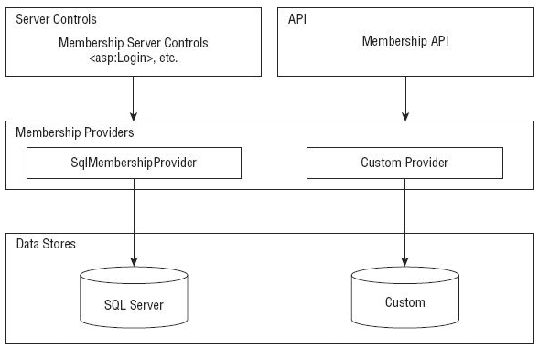
FIGURE 19-1 Server Controls Membership
Security—focused server controls that utilize the access granted by the underlying membership providers to work with the users in the authentication process.
Membership providers can access a wide variety of underlying data stores.
You can also build your own membership providers to get at any other custom data stores that work with user credentials.
In this diagram, you can see the built-in Microsoft SQL Server data store.

Slide 12
FROM SYSTEM .WEB.SECURITY TO SYSTEM.WEB.APPLICATION SERVICES
If you are migrating from a previous version of ASP.NET, you might notice that some ASP.NET membership types have been moved from system.Web.dll to System.Web.ApplicationServices.dll.
In the website model you are using, you will not notice this change because the new DLL is automatically used by ASP.NET during compilation.
You just need to make sure that ASP.NET 4.5 is used for compilation.
For older web application projects you are migrating to ASP.NET 4.5, you need to add a reference to System.Web.ApplicationServices.dll to your project.
The “breaking changes” whitepaper has a complete list of types that have been moved.

Slide 13
Adding an <authentication> Element to the web.conﬁg File
To have the forms authentication element in your web application work with the membership service, the ﬁrst step is to turn on forms authentication within the web.config ﬁle.
DEMO

Slide 14
Adding an <authentication> Element to the web.conﬁg File
The simple addition of the <authentication> element to the web.config ﬁle turns on everything that you need to start using the membership service provided by ASP.NET 4.5.
To turn on the forms authentication using this element, you simply give the value Forms to the mode attribute.
This is a forms authentication example, but other possible values of the mode attribute include Windows, Passport, or None.

Slide 15
Adding an <authentication> Element to the web.conﬁg File
IIS authentication schemes include basic, digest, and Integrated Windows Authentication.
Passport authentication points to a centralized service provided by Microsoft that offers a single login and core proﬁle service for any member sites.
It costs money to use Passport, which has also been deprecated by Microsoft.

Slide 16
Adding a <forms> Element to web.conﬁg File
Using forms authentication, you can provide users with access to a site or materials based upon credentials they input into a web—based form.
When an end user attempts to access a website, he is entering the site using anonymous authentication, which is the default authentication mode.
If he is found to be anonymous, he can be redirected (by ASP.NET) to a speciﬁed login page.
After the end user inputs the appropriate login information and passes the authentication process, he is provided with an HTTP cookie, which can be used in any subsequent requests.
You can modify the behavior of the forms—based authentication by deﬁning that behavior within a <forms> section in the web.config ﬁle.
DEMO

Slide 17
Adding a <forms> Element to web.conﬁg File
You can set these as you want, and you have plenty of options for values other than the ones that are displayed.
Also, as stated earlier, these values are not required.
You can use the membership service right away with only the authentication element conﬁgured.
You can change the behavior of the forms authentication system by adding this <forms> element to the web.config ﬁle.
If you do this, however, make sure that you have the <forms> element nested within the <authentication> element.

Slide 18
Possible attributes of the <forms> element:
name: Deﬁnes the name used for the cookie sent to end users after they have been authenticated. By default, this cookie is named .ASPXAUTH.
loginUrl: Speciﬁes the page location to which the HTTP request is redirected for logging in the user if no valid authentication cookie (.ASPXAUTH or otherwise) is found. By default, it is set to Login.aspx.
protection: Speciﬁes the amount of protection that you want to apply to the cookie that is stored on the end user’s machine after he has been authenticated. The possible settings include:
All (You should always attempt to use All)
None
Encryption
validation.

Slide 19
Possible attributes of the <forms> element:
timeout: Deﬁnes the amount of time (in minutes) after which the cookie expires. The default value is 30 minutes.
path: Speciﬁes the path for cookies issued by the application.
requireSSL: Deﬁnes whether you require that credentials be sent over an encrypted wire (SSL) instead of clear text.
slidingExpiration: Speciﬁes whether the timeout of the cookie is on a sliding scale.
Default value is true. End user’s cookie does not expire until 30 minutes (or the time speciﬁed in the timeout attribute) after the last request to the application has been made.
False: the cookie expires 30 minutes from the ﬁrst request.

Slide 20
Possible attributes of the <forms> element:
cookieless: Speciﬁes how the cookies are handled by ASP.NET. The possible values include:
UseDeviceProfile (default): Detects whether to use cookies based on the user agent of the device.
Usecookies: Requires that all requests have the credentials stored in a cookie.
AutoDetect: Auto-determines whether the details are stored in a cookie on the client or within the URI (it does this by sending a test cookie ﬁrst).
UseUri: Forces ASP.NET to store the details within the URI on all instances.

Slide 21
Adding Users
To add users to the membership service, you can register users into the Microsoft SQL Server Express Edition data store.
The Microsoft SQL Server provider for the membership system can use a SQL Server Express Edition ﬁle that is structured speciﬁcally for the membership service (and other ASP.NET systems, such as the role management system).
NOTE Of course, you can use a number of editions of Microsoft’s SQL Server to work through the examples in this book. With that said, this chapter uses the default database the membership system uses in creating users.

Slide 22
Adding Users
ASP.NET is set to automatically create this particular ﬁle for you if the appropriate ﬁle does not exist already.
To create the ASPNETDB.mdf ﬁle, you work with the ASP.NET server controls that utilize an aspect of the membership service.
When the application requires the ASPNETDB.mdf ﬁle, ASP.NET creates this ﬁle on your behalf in the App_Data folder.
After the data store is in place, it is time to start adding users to the data store.

Slide 23
Using the CreateUserWizard Server Control
The CreateUserWizard control enables you to plug registered users into your data store for later retrieval.
If a page in your application allows end users to register for your site, you want, at a minimum, to retrieve a login and password from the user and place these values in the data store.
This enables the end user to access these items later to log in to the application using the membership system.
To make your life as simple as possible, the CreateUserWizard control takes complete control of registration on your behalf.
DEMO

Slide 24
Using the CreateUserWizard Server Control
The user password in this table is not stored as clear text; instead, it is hashed, which is a one-way form of encryption that cannot be reversed easily.
When a user logs in to an application that is using the ASP.NET 4.5 membership service, his or her password is immediately hashed and then compared to the hashed password stored in the database.
If the two hashed strings do not compare, the passwords are not considered a match.

Slide 25
Using the CreateUserWizard Server Control
Storing clear-text passwords is considered a security risk, so you should never do so without weighing the risk involved.
A note regarding the passwords used in ASP.NET 4.5:
If you are having difﬁculty entering users because of a password error, it might be because ASP.NET requires strong passwords by default.
All passwords input into the system must be at least seven characters and contain at least one non— alphanumeric character (such as [, ] , ! , @ , #, or S).

Slide 26
Changing Password Requirements
You can actually change the behavior of the membership provider so that it doesn’t
This example shows the membership provider reworked for SQL Server so that it does not require any non- alphanumeric characters and allows passwords as small as three characters in length.
You do this by using the minRequiredNonalphanumericcharacters and minRequiredPasswordLength attributes.
With these in place, you can now create users with these password rules as set forth in these conﬁguration settings.
DEMO

Slide 27
Working with the CreateUserWizard Control
When you work with the CreateUserWizard control, be aware of the ContinueButtonClick() and the CreatedUser() events.
The ContinueButtonClick() event is triggered when the Continue button on the second page is clicked after the user has been successfully created.
The CreatedUser () event is triggered when a user is successfully created in the data store.

Slide 28
The ContinueButtonClick() event
After the user has been added to the membership service through the form provided by the CreateUserWizard control, he or she can click the Continue button to be redirected to another page in the application.
This is done with a simple Response.Redirect statement.
Remember when you use this event, you must add the following to the <asp : CreateUserWizard> control.
OnContinueButtonClick = "CreateUserWizard1_ContinueButtonClick"
DEMO

Slide 29
The CreatedUser() event
Use this event if you want to take any additional actions when a user is registered to the service.
protected void CreateUserWizard1_CreatedUser(object sender, EventArgs e)
{
// Code here
}

Slide 30
Incorporating Personalization Properties in the Registration Process
You can use the personalization management system that comes with ASP.NET 4.5 to store user-speciﬁc details.
The registration process provided by the CreateUserWizard control is an ideal spot to retrieve this information from the user to store directly in the personalization system.
The ﬁrst step, is to deﬁne some personalization points in the application’s web.config ﬁle.
DEMO

Slide 31
Incorporating Personalization Properties in the Registration Process
Now that these properties are deﬁned in the web.config ﬁle, you can use them when you create users in the ASP.NET membership system.
Again, using the CreateUserWizard control, you can create a process that requires the user to enter his or her preferred username and password in the ﬁrst step, and then the second step asks for these custom-deﬁned personalization points.
DEMO

Slide 32
Profilecommon Class in a Website
The direct, convenient access to proﬁle information is available only in the website model, not in the web application model (Chapter 18 provides more info).
Therefore, the Profilecommon class is available instead of the UserProfile class we created.
Profilecommon becomes available in a website model once you deﬁne proﬁle properties in web.config
If you are working with the web application model, you have to use a helper class as demonstrated.

Slide 33
Custom Steps
You can deﬁne a custom step within the CreateUserWizard control by using the <WizardSteps> element.
Within this element, you can construct a series of registration steps in whatever fashion you choose.
From the <WizardSteps> section, shown in our example, you can see that three steps are deﬁned.

Slide 34
Custom Steps
End user’s personalization properties are requested with the <asp:WizardStep> control.
Within the <asp:WizardStep> control, a table is laid out and a custom form is created.
Two additional steps were deﬁned in our example:
step to create the user (using the <asp:CreateUserWizardStep> control)
step to conﬁrm the creation of a new user (using the <asp:Comp1eteWizardStep> control)
The order in which these steps appear is the order in which they are presented to the end user.
After the steps are created the way you want, you can then store the custom properties using the CreateUserWizard control’s CreatedUser() event:

Slide 35
Custom Steps
After the steps are created the way you want, you can then store the custom properties using the CreateUserWizard control’s CreatedUser() event:
protected void CreateUserWizard1_CreatedUser(object sender, EventArgs e)
{
UserProfile pc = new UserProfile();
pc.Initialize(CreateUserWizard1.UserName.ToString(), true);
pc.FirstName = Firstname.Text;
pc.LastName = Lastname.Text;
pc.Age = Age.Text;
pc.Save();
}

Slide 36
Custom Steps
You are not limited to having a separate step in which you ask for personal bits of information; you can incorporate these items directly into the <asp:CreateUserWizardStep> step itself.
An easy way to do this is to switch to the Design View of your page and pull up the smart tag for the CreateUserWizard control.

Slide 37
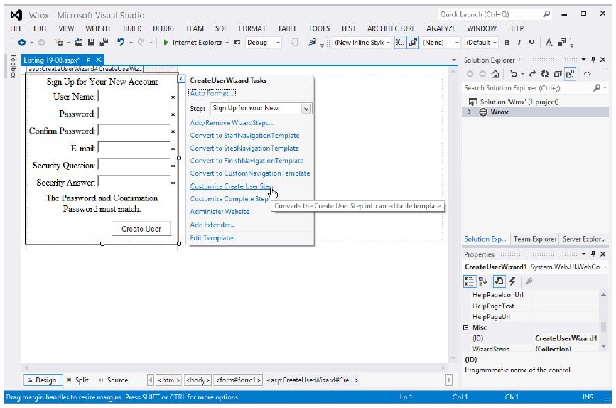
Customize Create User Step link
DEMO

Slide 38
Adding Users Programmatically
You are not limited to using only server controls to register or add new users to the membership service.
ASP.NET 4.5 provides a Membership API for performing this task programmatically.
This feature is ideal for creating your own mechanics for adding users to the service—or if you are modifying a web application that was created using ASP.NET 1.0/1.1.
The Membership API includes the CreateUser () method for adding users to the service.
DEMO

Slide 39
The CreateUser() method signatures:
Membership.CreateUser(username As String, password As String)
Membership.CreateUser(username As String, password As String, email As String)
Membership.CreateUser(username As String, password As String, email As String, passwordquestion As String, passwordAnswer As String, isApproved As Boolean, ByRef status As System.Web.Security.MembershipCreateStatus)
Membership.CreateUser(username As String, password As String, email As String, passwordquestion As String, passwordAnswer As String, isApproved As Boolean, providerUserKey As Object ByRef status As System.Web.Security.Member3hipCreateStatus)

Slide 40
Error Handling
You are able to look for the speciﬁc error that occurred in the CreateUser process.
List of available error codes includes the following:
Membershipcreatestatus.Dup1icateEmail
Membershipcreatestatus.DuplicateProviderUserKey
Membershipcreatestatus.DuplicateUserName
Membershipcreatestatus.Inva1idAnswer
Membershipcreatestatus.Inva1idEmail
Membershipcreatestatus.InvalidPassword
Membershipcreatestatus.InvalidProviderUserKey
Membershipcreatestatus.InvalidQuestion
Membershipcreatestatus.Inva1idUserName
Membershipcreatestatus.ProviderError
Membershipcreatestatus.Success
Membershipcreatestatus.UserRejected
In addition to giving better error reports to your users by deﬁning what is going on, you can use these events to take any actions that might be required.

Slide 41
Changing How Users Register with Your Application
<membership>
<providers>
<add
name="AspNetSqlMembershipProvider"
type="System.Web.Security.SqlMembershipProvider, System.Web, Version=4.0.0.0, Culture=neutral, PublicKeyToken=b03f5f7f11d50a3a"
connectionStringName="LocalSqlServer"
enablePasswordRetrieval="false"
enablePasswordRe3et="true"
require3QuestionAndAnswer="true"
applicationName="/"
requiresUniqueEmail="false"
passwordFormat="Hashed"
maxlnvalidPasswordAttempts="5"
minRequiredPasswordLength="7"
minRequiredNonalphanumericcharacters="1"
passwordAttemptWindow="10"
passwordStrengthRegularﬁxpression="" />
</providers>
</membership>
You determine how users register with your applications and what is required of them by the membership provider you choose.
You will ﬁnd a default membership provider and its applied settings are established within the machine.config ﬁle.

Slide 42
Changing How Users Register with Your Application
This section of the machine.config ﬁle shows the default membership provider that comes with ASP.NET 4.5 — named AspNetSqlProvider.
If you are adding membership providers for server- wide use, add them to this <membership> section of the machine.config ﬁle;
If you intend to use them for only a speciﬁc application instance, you can add them to your application’s web.config ﬁle.

Slide 43
Changing How Users Register with Your Application
The important attributes of the SqlMembershipProVider deﬁnition include
enablePasswordRetrieval
enablePasswordReset
requiresQuestionAndAnswer
requiresUniqueEmail
PasswordFormat attributes
Table 19-1 deﬁnes these attributes.
In addition to having these items deﬁned in the machine.config ﬁle, you can also redeﬁne them again (thus overriding the settings in the machine.config) in the web.config ﬁle.

Slide 44
TABLE 19-1
ATTRIBUTE | DESCRIPTION
EnablePasswordRetrieval | Deﬁnes whether the provider supports password retrievals. Takes a Boolean value. Default value is False. When it is set to False, passwords cannot be retrieved although they can be changed with a new random password.
enablePasswordReset | Deﬁnes whether the provider supports password resets. Takes a Boolean value. The default value is True.
requiresQuestionAndAnswer | Speciﬁes whether the provider should require a question-and-answer combination when a user is created. Takes a Boolean value, and the default value is False.
requiresUniqueEmail | Deﬁnes whether the provider should require a unique e-mail to be speciﬁed when the user is created. Takes a Boolean value, and the default value is False. When set to True, only unique email addresses can be entered into the data store.
passwordFormat | Deﬁnes the format in which the password is stored in the data store. The possible values include Hashed, Clear, and Encrypted. The default value is Hashed. Hashed passwords use SHA1, whereas encrypted passwords use Triple-DES encryption.

Slide 45
Asking for Credentials
After you have users who can access your web application using the membership service provided by ASP.NET, you can then give these users the means to log in to the site.
This requires little work on your part.
Before you learn about the controls that enable users to access your applications, you should make a few more modiﬁcations to the web.config ﬁle.

Slide 46
Turning Off Access with the <authorization> Element
Changing the web.config ﬁle by adding the <authentication> and <forms> elements, your web application is accessible to each and every user that browses to any page your application contains.
To prevent open access, you have to deny unauthenticated users access to the pages of your site.
Using the <authorization> and <deny> elements, you can deny speciﬁc users access to your web application—or (as in this case) simply deny every unauthenticated user (this is what the question mark signiﬁes).
<authentication mode="Forms"/>
<authorization> <deny users="?" /> </authorization>

Slide 47
Login Server Control
Enables you to turn unauthenticated users into authenticated users by allowing them to provide login credentials
In the examples so far, you have used Microsoft SQL Server Express Edition as the data store
Can use the full—blown version of Microsoft’s SQL Server

Slide 48
Login Server Control
Login.aspx is default page to which unauthenticated users are redirected to obtain their credentials.
Can change this behavior by changing the value of the <forms> element’s loginUrl attribute in the web.config ﬁle.
Login.aspx page needs an <asp:Login> control to give the end user everything he or she needs to become authenticated.
DEMO

Slide 49
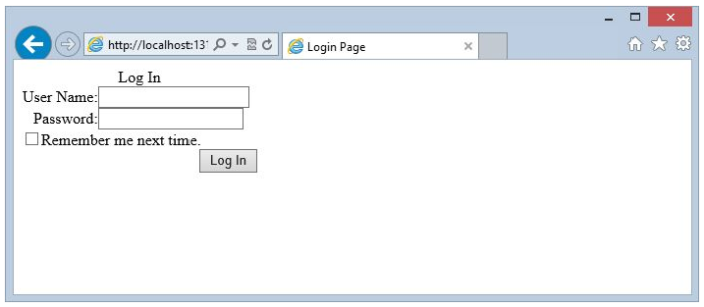
Login Server Control
If the unauthenticated user hits a different page in the application, he or she is redirected to the Login.aspx page.
You can see how ASP.NET tracks the location in the URL from the address bar in the browser:
http://localhost:1315/Membership/Login.aspx?ReturnUrl=%2fMembership%2fDefault.aspx

Slide 50
Login Server Control
The Login control asks the user for a username and password.
A check box allows a cookie to be stored on the client machine.
This cookie enables the end user to bypass future logins.
You can remove the check box and related text created to remember the user by setting the Login control’s DisplayRememberMe property to False.

Slide 51
RememberMeText and RememberMeSet
RememberMeText property deﬁnes the text set next to the check box.
The RememberMeSet property takes a Boolean value (by default, it is set to False)
Speciﬁes whether to set a persistent cookie on the client’s machine.
True, the check box is checked by default.

Slide 52
Login Server Control
If the DisplayRememberMe property is set to False (meaning the end user does not see the check box or cannot select the option of persisting the login cookie) and RememberMeSet is set to True, a cookie is set on the user's machine automatically without the user’s knowledge or choice in the matter.
You should think carefully about taking this approach because end users sometimes use public computers, and this method would mean you are setting authorization cookies on public machines.

Slide 53
Login Server Control
This cookie remains on the client’s machine until the user logs out of the application (if this option is provided).
With the persisted cookie, and assuming the end user has not logged out of the application, the user never needs to log in again when he returns to the application because his credentials are provided by the contents found in the cookie.

Slide 54
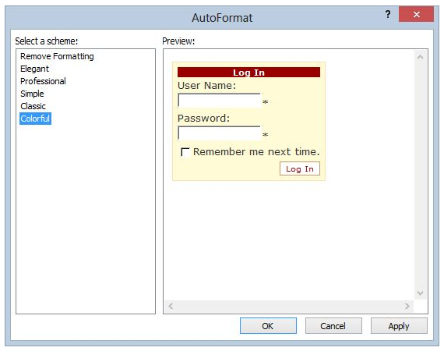
Login Server Control
After the end user has logged in to the application, he is returned to the page he originally intended to access.
You can also modify the look—and—feel of the Login control just as you can for the other controls.
One way to do this is by clicking the Auto Format link in the control’s smart tag.
There you ﬁnd a list of options for modifying the look—and—feel of the control

Slide 55
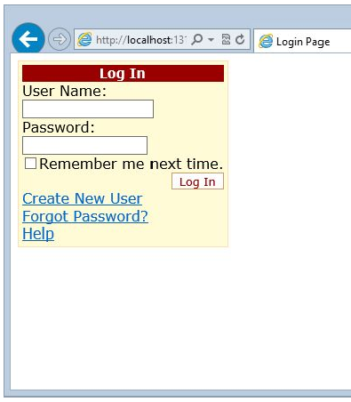
Login Server Control
An interesting change you can make is to add some links at the bottom of the control to provide access to additional resources.
With these links, you can give users the capability to get help or register for the application so that they can be provided with any login credentials.
You can provide links to do the following:
Redirect users to a help page
Redirect users to a page that allows them to recover their forgotten passwords using the PasswordRecoveryText , PasswordRecoveryUrl, and PasswordRecoveryIconUrl property.

Slide 56
Logging In Users Programmatically
Besides using the prebuilt mechanics of the Login control, you can also perform this task programmatically using the Membership class.
To validate credentials that you receive, you use the ValidateUser() method of this class.
The ValidateUser() method returns a Boolean value of True if the user credentals pass the test and False if they do not.
DEMO

Slide 57
Locking Out Users Who Provide Bad Passwords
When providing a user login form in any application you build, always guard against repeated bogus password attempts.
If you have a malicious end user who knows a username, he may try to access the application by repeatedly trying different passwords.
You want to guard against this kind of activity.
You don’t want to allow this person to try hundreds of possible passwords with this username.

Slide 58
Locking Out Users Who Provide Bad Passwords
ASP.NET has built-in protection against this type of activity.
If you look in the aspnet_Membership table, you see two columns focused on protecting against this activity.
These columns are FailedPasswordAttemptCount and FailedPasswordAttemptWindowStart.
By default, a username can be used with an incorrect password in a login attempt only ﬁve times within a 10-minute window.
On the ﬁfth failed attempt, the account is locked down.

Slide 59
Locking Out Users Who Provide Bad Passwords
You do this in ASP.NET by setting the IsLocked0ut column to True.
You can actually control the number of password attempts that are allowed and the length of the attempt window for your application.
These two items are deﬁned in the SqlMembershipProvider declaration in the machine.config ﬁle.
You can change the values either in the server—wide conﬁguration ﬁles or in your application’s web.config ﬁle.
DEMO

Slide 60
Locking Out Users Who Provide Bad Passwords
To determine the number of password attempts that are allowed, use maxInva1idPasswordAttempts.
This example changes the value to 3, meaning that users are allowed to enter an incorrect password three times before being locked out (within the time window deﬁned).
The default value of the maxInva1idPasswordAttempts attribute is 5.
You can set the time allowed for bad password attempts to 15 minutes using the passwordAttemptWindow attribute.
The default value of this attribute is 10, so an extra ﬁve minutes is added.

Slide 61
Locking Out Users Who Provide Bad Passwords
The IsLockedout property is read through an instantiation of the MembershipUser object.
This object gives you programmatic access to the user data points contained in the aspnet_Membership table.
In this case, the IsLocked0ut property is retrieved and displayed to the screen.
The MembershipUser object also exposes a lot of available methods—one of which is the UnlockUser() method.
This method is invoked if the check box is selected in the button-click event.

Slide 62
Working with Authenticated Users
After users are authenticated, ASP.NET 4.5 provides a number of different server controls and methods that you can use to work with the user details.
Included in this collection of tools are the:
Loginstatus
LoginName controls.

Slide 63
The LoginStatus Server Control
The Loginstatus server control enables users to click a link to log in or log out of a site.
To use this control, remove the <deny> element from the web.config ﬁle so that the pages of your site are accessible to unauthenticated users
Then code your Default.aspx page so that it includes a LoginStatus Control:
<asp:LoginStatus ID="LoginStatus1" Runat="server" />
DEMO

Slide 64
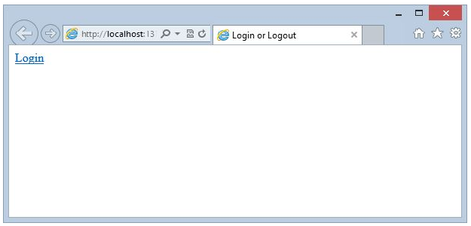
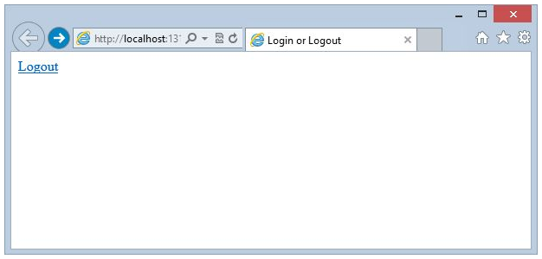
The LoginStatus Server Control
Running this gives you a simple page that contains only a hyperlink titled Login.
Clicking the Login hyperlink forwards you to the Login.aspx page where you provide your credentials.
After the credentials are provided, you are redirected to the Default.aspx page — although now the page includes a hyperlink titled Logout.
The Linkstatus control displays one link when the user is unauthenticated and another link when the user is authenticated.
Clicking the Logout hyperlink logs out the user and redraws the Default.aspx page — but with the Login hyperlink in place.

Slide 65
The LoginName Server Control
The LoginName server control enables you to display the username of the authenticated user.
This practice is common today.
For an example of it, change the Default.aspx page so that it now includes the authenticated user’s login name when that user is logged in, as illustrated in Listing 19- 19.
DEMO

Slide 66
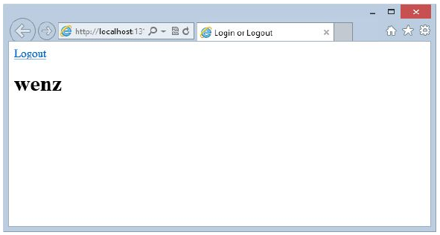
The LoginName Server Control
When the user logs in to the application and is returned to the Default.aspx page, the users sees their username displayed, as well as the hyperlink generated by the Loginstatus control.

Slide 67
The LoginName Server Control
In addition to just showing the username of the logged—in user, you can also add text by using the LoginName control’s Formatstring property.
To provide a welcome message along with the usemame, you construct the LoginName control as follows:
<asp:LoginName ID="LoginName1" Runat=“Server" FormatString="Welcome to our Website {0}!" />
You can also use the following construction in one of the page events.
LoginName1.FormatString = "Welcome to the site {O}!";

Slide 68
The LoginName Server Control
When the page is generated, ASP.NET replaces the {0} part of the string with the username of the logged-in user.
This provides you with a result similar to the following:
Welcome to the site Christian!
If you do not want to show the username when using the LoginName control, simply omit the {0} aspect of the string.
The control then places the FormatString property’s value on the page.

Slide 69
Showing the Number of Users Online
One cool feature of the membership service is that you can display how many users are online at a given moment.
This option is an especially popular one for a portal or a forum that wants to impress visitors to the site with its popularity.
To show the number of users online, you use the GetNumberofUsersOnline method provided by the Membership class.
DEMO

Slide 70
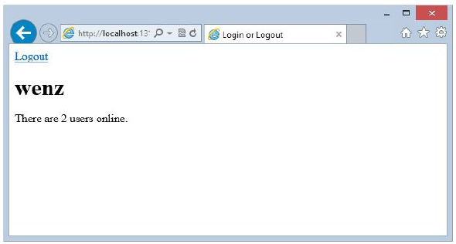
Showing the Number of Users Online
When the page is generated, it displays the number of users who have logged on in the last 15 minutes.
You can see that two users have logged on in the last 15 minutes.
This 15-minute period is determined in the machine.config ﬁle from within the <membership> element:
<membership userIsOnlineTimeWindow="15"> </membership>
By default, the userIsOnlineTimeWindow is set to 15.
To increase the time window, you simply increase this number.
In addition to specifying this number from within the machine.config ﬁle, you can also set this number in the web.config ﬁle.

Slide 71
Dealing with Passwords
Many of us seem to spend our lives online and have username/password combinations for many different websites on the Internet.
End users forget passwords or want to change them every so often.
ASP.NET provides a couple of server controls that work with the membership service so that end users can either change their passwords or retrieve forgotten passwords.
DEMO

Slide 72
The ChangePassword Server Control
The ChangePassword server control enables end users to change their passwords directly in the browser.
Remember that end users are allowed to change their passwords because the enablePasswordReset attribute of the membership provider is set to true.
To deny this capability, set the enablePasswordReset attribute to false.
To enable this capability, set the enablePasswordReset attribute to true.

Slide 73
The ChangePassword Server Control
You can also specify rules on how the passwords must be constructed when an end user attempts to change her password.
The NewPasswordRegularExpression attribute specifies the construction required for the new password with a regular expression:
NewPasswordRegularExpression='@\"(?=.{6,})(?=(.*\d){1,})(?=(.*\W){1,})'
Any new passwords created by the end user are checked against this regular expression.
See http://msdn.microsoft.com/en-us/library/az24scfc.aspx for info on regular expressions.
Setting a NewPasswordRegularExpressionErrorMessage attribute causes an error message to appear within the control output.

Slide 74
The PasswordRecovery Server Control
Provides a way for users to retrieve passwords from your data store when forgotten.
Password recovery usually means sending the end user’s password to that user in an e-mail.
May need to set up an SMTP server (it might be the same as the application server).
You conﬁgure for SMTP in the web.config ﬁle.
DEMO

Slide 75
<MailDefinition> Subelement
The <asp:PasswordRecovery> element needs a <MailDefinition> subelement.
The <MailDefinition> element contains details about the e-mail to be sent to the end user.
The minimum requirement is that the From attribute is used, which provides the e-mail address for the From part of the e- mail.
The String value of this attribute should be an e-mail address.
Other attributes for the <MailDefinition> element include the following:
BodyFileName
CC
From
IsBodyHtml
Priority
Subject

Slide 76
The PasswordRecovery Server Control
When it has the username, the membership service retrieves the question and answer that was earlier entered by the end user.
If the question is answered correctly (notice that the answer is case sensitive), an e- mail containing the password is generated and mailed to the end user.
If the question is answered incorrectly, an error message is displayed.
A question will not be used if you have the question answer feature of the membership system disabled.
NOTE If you do not have a mail server available, we recommend using the open source mail server simulator from h@:[ [sm1:p4dev.codeplex.com[ which does not actually send an e-mail, but displays them.
This makes debugging this feature so much easier.

Slide 77
The PasswordRecovery Server Control
By default, the membership service data store is not storing the actual password — just a hashed version of it.
Therefore you do not get the original password, but a new one that was generated by ASP.NET for you.
For you to be able to send back an actual password to the user, you must change how the passwords are stored in the membership service data store.
You do this (as stated earlier in the chapter) by changing the PasswordFormat attribute of your membership data provider.
The other possible values (besides Ha shed) are Clear and Encrypted.
Changing the value to either Clear or Encrypted makes it possible for the passwords to be sent back to the end user in a readable format.

Slide 78
Generating Random Passwords
Certain applications must generate a random password when you create a user.
ASP.NET includes a helper method that enables you to retrieve random passwords.
To generate a password randomly in ASP.NET, you can use the GeneratePassword () helper method.
This method enables you to generate a random password of a speciﬁed length, and you can specify how many non— alphanumeric characters the password should contain (at minimum).

Slide 79
ASP.NET 4.5 AUTHORIZATION
Now that you can deal with the registration and authentication of users who want to access your web applications, the next step is authorization.
What are they allowed to see and what roles do they take?
Using the LoginView control, you can dictate which parts of the pages are for authenticated users and which parts of the pages are for unauthenticated users.
DEMO

Slide 80
ASP.NET 4.5 AUTHORIZATION
Only simple ASCII text is placed inside both of these templates, but you can actually place anything else within the template including additional server controls.
This means that you can show entire sections of pages, including forms, from within the templated sections.
Besides using just the <LoggedInTemplate> and the <AnonymousTemplate> of the LoginView control, you can also enable sections of a page or speciﬁc content for entities that are part of a particular role — such as someone who is part of the Admin group.

Slide 81
Role Groups
To show content for a particular group of users, you add a <RoleGroups> element to the LoginView control.
The <RoleGroups> section can take one or more RoleGroup controls (you will not ﬁnd this control in Visual Studio’s Toolbox).
To provide content to display using the RoleGroup control, you provide a <ContentTemplate> element, which enables you to deﬁne the content to be displayed for an entity that belongs to the speciﬁed role.
What is placed in the <ContentTemplate> section completely depends on you.
You can place raw text (as shown in the example) or even other ASP.NET controls.
DEMO

Slide 82
Role Groups
Be cautious of the order in which you place the deﬁned roles in the <RoleGroups> section.
When users log in to a site, they are ﬁrst checked to see whether they match one of the deﬁned roles.
The ﬁrst (uppermost) role matched is the view used for the LoginView control — even if they match more than one role.

Slide 83
Role Groups
You can also place more than one role in the Roles attribute of the <asp:RoleGroups> control, like this:
<asp:RoleGroup Roles="CoolPeople, HappyPeople">
<ContentTemplate>
You are cool or happy (or both)!
</ContentTemplate>
</asp:RoleGroup>

Slide 84
Setting Up Your Website for Role Management
In addition to the membership service just reviewed, ASP.NET provides you with the other side of the end-user management service—the ASP.NET role management service.
The membership service covers all the details of authentication for your applications, whereas the role management service covers authorization.
Just as the membership service can use any of the data providers listed earlier, the role management service can also use a provider that is focused on SQL Server (SqlRoleProvider) or any custom providers.
In fact, this service is comparable to the membership service in many ways.

Slide 85
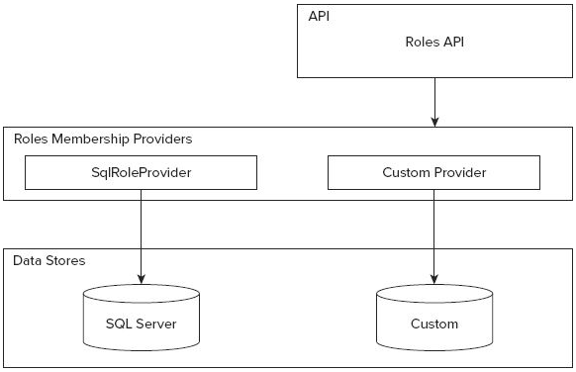
FIGURE 19-21 Roles and Roles Membership Providers

Slide 86
Role Management
The ﬁrst step in working with the role management service is to change any of the role management provider’s behaviors either in the machine.config or from the web.config ﬁles.
If you look in the machine.config.comments ﬁle, you will see an entire section that deals with the role management service (see Listing 19-28).

Slide 87
LISTING 19- 28: Role management provider settings in the machine.conﬁg.comments ﬁle
<roleManager
enabled="false"
cacheRolesInCookie="false"
cookieName=".ASPXROLES"
cookieTimeout="30"
cookiePath="/"
cookieRequireSSL="false"
cookieSlidingExpiration="true"
cookieProtection="All"
defaultProvider="AspNetSqlRoleProvider"
createPersistentCookie="false"
maxCachedResults="25“>
<providers>
<clear />
<add
connectionStringName="LocalSqlServer"
applicationName="/"
name="AspNetSqlRoleProvider"
type="System.Web.Security.SqlRoleProvider, System.Web, Version=4.0.0.0, Culture=neutral, PublicKeyToken=b03f5f7f11d50a3a" />
<add
applicationName="/"
name="AspNetWindowsTokenRoleProvider"
type="System.Web.Security.WindowsTokenRoleProvider, System.Web, Version=4.0.0.0, Culture=neutral, PublicKeyToken=b03f5f7f11d50a3a" />
</providers>
</roleManager>

Slide 88
Table 19-2 <roleManager> elements
ATTRIBUTE | DESCRIPTION
enabled | Deﬁnes whether the role management service is enabled for the application.
cacheRolesInCookie | Deﬁnes whether the roles of the user can be stored within a cookie on the client machine.
cookieName | Defines the name used for the cookie sent to the end user for role management information storage.
cookieTimeout | Defines the amount of time (in minutes) after which the cookie expires.
cookieRequireSSL | Defines whether you require that the role management information be sent over an encrypted wire (SSL) instead of being sent as clear text.
cookieSlidingExpiration | Speciﬁes whether the timeout of the cookie is on a sliding scale.
cookieProtection | Speciﬁes the amount of protection you want to apply to the cookie stored on the end user’s machine for management information.
defaultProvider | Defines the provider used for the role management service.

Slide 89
Making Changes to the web.conﬁg File
The next step is to conﬁgure your web.config ﬁle so that it can work with the role management service.
Certain pages or subsections of your application may be accessible only to people with speciﬁc roles.
To manage this access, you deﬁne the access rights in the web.config ﬁle.
DEMO

Slide 90
Making Changes to the web.conﬁg File
The <deny> element is denying all unauthenticated users across the board.
The second section of this web.config ﬁle is rather interesting.
The <location> element is used to deﬁne the access rights of a particular page in the application (AdminPage.aspx).
In this case, only users contained in the AdminPageRights role are allowed to view the page, but all other users — regardless of whether they are authenticated — are not allowed to view the page.
When using the asterisk (*) as a value of the users attribute of the <deny> element, you are saying that all users (regardless of whether they are authenticated) are not allowed to access the resource being deﬁned.
This overriding denial of access, however, is broken open a bit via the use of the <allow> element, which allows users contained within a speciﬁc role.

Slide 91
Adding and Retrieving Application Roles
Now that the machine.config or the web.config ﬁle is in place, you can add roles to the role management service.
The role management service, just like the membership service, uses data stores to store information about the users.
These examples focus primarily on using Microsoft SQL Server Express Edition as the provider because it is the default provider.
One big difference between the role management service and the membership service is that no server controls are used for the role management service.
You manage the application’s roles and the user’s role details through a Roles API or through the Web Site Administration Tool provided with ASP.NET 4.5.
DEMO

Slide 92
DeleteRole () method signatures.
The ﬁrst option of the DeleteRole() method takes a single parameter—the name of the role as a String value.
Roles.DeleteRole (rolename As String)
The second option takes the name of the role plus a Boolean value that determines whether to throw an exception when one or more members are contained within that particular role (so that you don’t accidentally delete a role with users in it when you don’t mean to):
Roles.DeleteRole(rolename As String, throwOnPopulatedRole As Boolean)
DEMO

Slide 93
Adding Users to Roles
To add a single user to a single role, you use the following construct:
Roles.AddUserToRole(username As String, rolename As String)
To add a single user to multiple roles at the same time, you use this construct:
Roles.AddUserToRoles(username As String, rolenames() As String)
To add multiple users to a single role, you use the following construct:
Roles.AddUsersToRole(usernames() As String, rolename As String)
Finally, to add multiple users to multiple roles, you use the following construct:
Roles.AddUsersToRoles(usernames() As String, rolenames() As String)
The parameters that can take collections, whether they are usernames() or rolenames() , are presented to the method as String arrays.

Slide 94
Getting All the Users of a Particular Role
Looking up information is easy in the role management service
Determining which users are contained within a particular role
Know the roles to which a particular user belongs.
Methods are available for either of these scenarios.
DEMO

Slide 95
Removing Users from Roles
In addition to adding users to roles, you can also easily remove users from roles.
To delete or remove a single user from a single role, you use the following construct:
Roles.RemoveUserFromRole(username As String, rolename As String)
To remove a single user from multiple roles at the same time, you use this construct:
Roles.RemoveUserFromRole(username As String, rolename As String)
To remove a single user from multiple roles at the same time, you use this construct:
Roles.RemoveUserFromRoles(username As String, rolenames() As String)
To remove multiple users from a single role, you use the following construct:
Roles.RemoveUsersFromRole(usernames() As String, rolename As String)
Finally, to remove multiple users from multiple roles, you use the following construct:
Roles.RemoveUser3FromRoles(usernames() As String, rolenames() As String)
The parameters shown as collections, whether they are usernames () or rolenames () , are presented to the method as String arrays.

Slide 96
Checking Users in Roles
One ﬁnal action you can take is checking whether a particular user is in a role.
The ﬁrst is using the IsUserInRole() method.
Roles.IsUserInRole(username As String, rolename As String)
This method returns a Boolean value on the status of the user.
if (Roles.IsUserInRole(TextBox1.Text, "AddingPageRights"))
{
// perform action here
}

Slide 97
Checking Users in Roles
The other option is to use FindUsersInRole() method.
This method enables you make a name search against all the users in a particular role.
Roles.FindUsersInRole(rolename As String, username As String)
protected void Button1_Click(object sender, EventArgs e)
{
GridView1.DataSource = Roles.FindUsersInRole("AdinPageRights", TextBox1.Text);
GridView1.DataBind();
}

Slide 98
Understanding How Roles Are Cached
By default, after you retrieve a user’s roles from the data store underlying the role management service, you can store these roles as a cookie on the client machine.
You do this so you do not have to access the data store each and every time the application needs a user’s role status.
A bit of risk always exists when working with cookies because the end user can manipulate the cookie and thereby gain access to information or parts of an application that normally would be forbidden to that particular user.

Slide 99
Understanding How Roles Are Cached
Although roles are cached in a cookie, the default is that they are cached for only 30 minutes at a time.
You can deal with this role cookie in several ways — some of which might help to protect your application better.
One protection for your application is to delete this role cookie, using the Deletecookie () method of the Roles API, when the end user logs on to the site.
if (Membership.ValidateUser(TextBox1.Text, TextBox2.Text)
{
Roles.DeleteCookie();
Formshuthentication.RedirectFromLoginPage(TextBox1.Text, false);
}
else
{
Label1.Text = "You are not registered with the site.";
}

Slide 100
Using Roles
Deletecookie () does exactly what you would think — it deletes from the client machine any cookie that is used to deﬁne the user’s roles.
If the end user is re—logging in to the site, no problem should arise with re—authenticating his exact roles within the application.
There is no need to rely on the contents of the cookie.
This step provides a little more protection for your site.

Slide 101
USING THE WEB SITE ADMINISTRATION TOOL
You can also perform many of the actions shown in this chapter through the Web Site Administration Tool shown in Figure 19-25.
You can get at the ASP.NET Web Site Administration Tool by selecting Website => ASP.NET Conﬁguration from the Visual Studio 2012 menu.

Slide 102
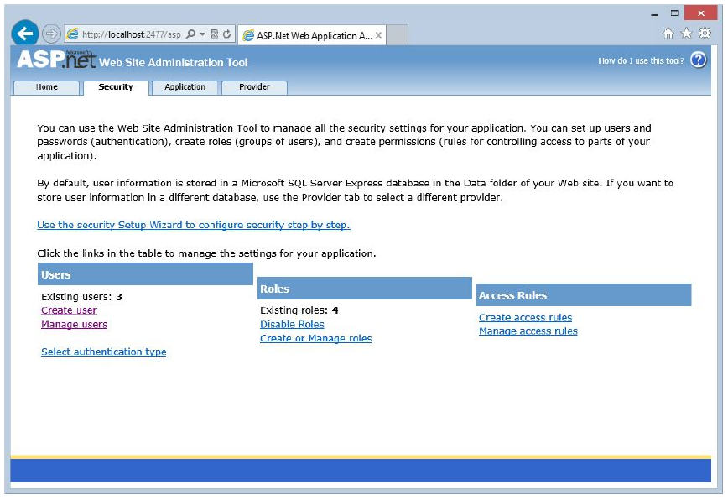
Figure 19-25
DEMO

